Slide 1
UNIT- I
Introduction

Slide 2
Syllabus
String
Alphabet
Language
Operations
Finite Automaton model
Acceptance of Strings & Languages
Chomsky hierarchy of languages
Deterministic finite automaton
Non deterministic finite automaton
NFA to DFA conversion
equivalence of DFA ‘s

Slide 3
Introduction
Automata: it is a mathematical model or abstract model.
It takes some input
Processes it using rules.
Produces an output( accepts or rejects the input).
It is helpful for check whether the given string belongs to language or not.
Finite automata : it is a model (or) machine which runs in a finite state is called finite automata.

Slide 4
Representation & Notations used in Automata
Symbols: Symbols are an entity or individual objects, which can be any letter, alphabet or any picture.
Example: 1, a, b, #
Alphabets: Alphabets are a finite set of symbols. It is denoted by ∑.
Examples: ∑ = {a, b} , ∑ = {A, B, C, D} , ∑ = {0, 1, 2} , ∑ = {0, 1, ....., 5] , ∑ = {#, β, Δ}
String: it is a collection of symbols over alphabet. The string is denoted by w.
Example 1:
If ∑ = {a, b}, various string that can be generated from ∑ are {ab, aa, aaa, bb, bbb, ba, aba.....}.
A string with zero occurrences of symbols is known as an empty string. It is represented by ε.
The number of symbols in a string w is called the length of a string. It is denoted by |w|.
Example 2: w = 010
Number of Sting |w| = 3

Slide 5
Language
It is a collection or set of all strings over alphabet.
It is represented as ‘L’
A language which is formed over Σ can be Finite or Infinite.
Given an alphabet I, a language L is a set of strings, that is a subset of the universal language I.
Example: 1
L1 = {Set of string of length 2} = {aa, bb, ba, bb} Finite Language
Example: 2
L2 = {Set of all strings starts with 'a'} = {a, aa, aaa, abb, abbb, ababb…} Infinite Language

Slide 6
Operations
On languages we can define the usual set operations that are.
union
intersection
Complement
Let L1 = {10} and L2 = {011, 11}.
Union: L1 𝖴 L2 = {10, 011, 11}
Concatenation: L1 L2 = {10011, 1011}
Kleene Star: L1 * = {e, 10, 1010, 101010, … }

Slide 7
Power of ‘∑’
Ex:-∑ = {a,b}
∑ = set of all strings with length ‘0’. Sol: ε
∑ = set of all strings with length ‘1’. Sol: {a,b}
∑ = set of all strings with length ‘2’.
Sol: ∑. ∑={a,b} {a,b}={aa,ab,ba,bb}
∑ = set of all strings with length ‘3’.
∑. ∑. ∑ ={a,b} {a,b} {a,b}
= {aa.ab,ba,bb}{a,b}= {aaa,,aab,aba,abb,baa,bab,bba,bbb}
.
.
∑ (Kleene Closure): it is set of all strings of all length possible on {a,b} is called kleene closure.
It is a infinite language
∑ (Positive Closure): all strings possible but ε is not available.
Formula: ∑ = ∑ + ∑
∑ - ε = ∑
0
1
2
3
*
+
*
+
0
*
+

Slide 8
Finite Automata
Finite automata are used to recognize patterns.
It takes the string of symbol as input and changes its state accordingly. When the desired symbol is found, then the transition occurs.
At the time of transition, the automata can either move to the next state or stay in the same state.
Finite automata have two states, Accept state or Reject state. When the input string is processed successfully, and the automata reached its final state, then it will accept.
Formal Definition of FA
A finite automaton is a collection of 5-tuple (Q, ∑, δ, q0, F), where:
Q: finite set of states
∑: finite set of the input symbol
q0: initial state
F: final state
δ: Transition function

Slide 9
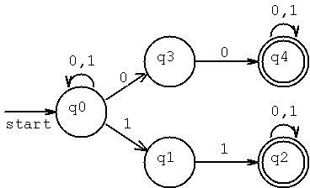
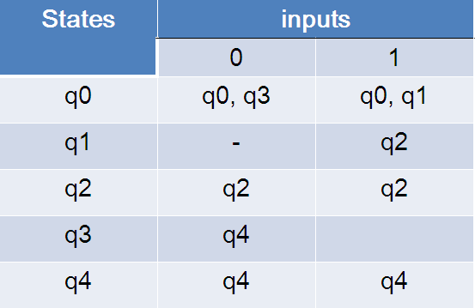
Transition Diagram:-
A transition diagram or state transition diagram is a directed graph which can be constructed as follows:
There is a node for each state in Q, which is represented by the circle.
There is a directed edge from node q0 to node q1 labeled a if δ(q0, a) = q1.
In the start state, there is an arrow with no source.
Accepting states or final states are indicating by a double circle.
Transition Table:-
The transition table is basically a tabular representation of the transition function. It takes two arguments (a state and a symbol) and returns a state (the "next state").
A transition table is represented by the following things:
Columns correspond to input symbols.
Rows correspond to states.
Entries correspond to the next state.
The start state is denoted by an arrow with no source.
The accept state is denoted by a star.
Example
0
Symbol | 0 | 1
q0 | q0 | q1
*q1 | q1 | q0
0
States
q0
1
q1
1

Slide 10
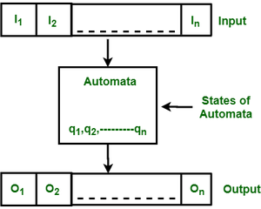
Finite automata
Finite automata are abstract machines used to recognize patterns in input sequences, forming the basis for understanding regular languages in computer science.
They consist of states, transitions, and input symbols, processing each symbol step-by-step.
If the machine ends in an accepting state after processing the input, it is accepted; otherwise, it is rejected.
Automata can be construct with help of
States: it represent as circle with state name.
Transitions: directed edge between two states.
Initial state: state with an edge from no source.
Final state: represented as double circle with state name.
Features of Finite Automata
Input: Set of symbols or characters provided to the machine.
Output: Accept or reject based on the input pattern.
States of Automata: The conditions or configurations of the machine.
State Relation: The transitions between states.
Output Relation: Based on the final state, the output decision is made.

Slide 11
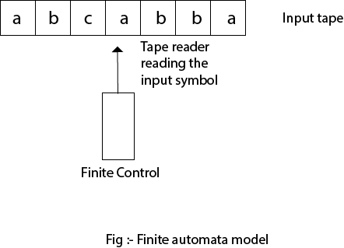
Finite Automata Model
Finite automata can be represented by input tape and finite control.
Input tape: It is a linear tape having some number of cells. Each input symbol is placed in each cell.
Finite control: The finite control decides the next state on receiving particular input from input tape. The tape reader reads the cells one by one from left to right, and at a time only one input symbol is read.

Slide 12
Acceptance of String& Language :
A String is said to be accepted by a FA M=(Q,∑,δ,q0,F) if δ(q0,x)=p for some p in F.
A language is accepted if all the strings generated from the language is accepted.
A language is said to be regular if it is the set accepted by a FA M(Finite Automata Machine).
Ex: δ(q0,111)= δ(δ(δ(q0,1),11)
= δ(δ(q0,1),1)
= δ(q1,1)
= q2 ϵ F String is accepted.
Acceptance of Strings:
Scan the entire String, if the input string reaches to the final state from initial state in a given Finite Automata(either DFA or NFA) then it is said to be string is accepted.
Acceptance of language:
A language is said to be accepted, if all the strings in the language are accepted and some strings not in the language are rejected in Finite Automata(FA).

Slide 13
Chomsky hierarchy of languages
According to Noam Chomsky, there are four types of grammars − Type 0, Type 1, Type 2, and Type 3. The following table shows how they differ from each other −
Grammar Type | Grammar Accepted | Language Accepted | Automaton
Type 0 | Unrestricted grammar | Recursively enumerable language | Turing Machine
Type 1 | Context-sensitive grammar | Context-sensitive language | Linear-bounded automaton
Type 2 | Context-free grammar | Context-free language | Pushdown automaton
Type 3 | Regular grammar | Regular language | Finite state automaton

Slide 14
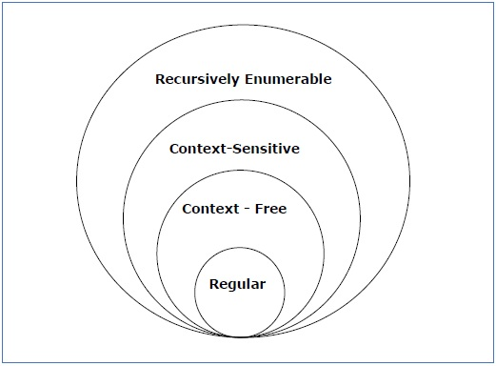
Chomsky hierarchy of languages
Take a look at the following illustration. It shows the scope of each type of grammar −

Slide 15
Chomsky hierarchy of languages
Type 3: Regular Grammar:Type-3 grammars generate regular languages.
These languages are exactly all languages that can be accepted by a finite-state automaton. Type 3 is the most restricted form of grammar.
Type 3 should be in the given form only :
V --> VT / T (left-regular grammar) (or) V --> TV /T (right-regular grammar) For example:
S --> a The above form is called strictly regular grammar.
There is another form of regular grammar called extended regular grammar. In this form:
V --> VT* / T*. (extended left-regular grammar) (or) V --> T*V /T* (extended right-regular grammar) For example :
S --> ab.

Slide 16
Chomsky hierarchy of languages
Type 2: Context-Free Grammar:
Type-2 grammars generate context-free languages.
The language generated by the grammar is recognized by a Pushdown automata
In Type 2:
First of all, it should be Type 1.
The left-hand side of production can have only one variable and there is no restriction on β
∣α∣=1.
For example:
S --> AB A --> a B --> b

Slide 17
Chomsky hierarchy of languages
Type 1: Context-Sensitive Grammar:
Type-1 grammars generate context-sensitive languages.
The language generated by the grammar is recognized by the Linear Bound Automata
In Type 1
First of all Type 1 grammar should be Type 0.
The no.of symbols on the left side of the production cannot more than no.of symbols on the right side of the production.
Grammar Production in the form of
α→β ∣α∣<=∣β∣
For Example:
S --> AB AB --> abc B --> b

Slide 18
Chomsky hierarchy of languages
Type 0: Unrestricted Grammar:
Type-0 grammars include all formal grammar. Type 0 grammar languages are recognized by Turing machine. These languages are also known as the Recursively Enumerable languages.
Grammar Production in the form of α→β where
α is ( V + T)* V ( V + T)* V : Variables T : Terminals.
β is ( V + T )*.
In type 0 there must be at least one variable on the Left side of production.
For example:
Sab --> ba A --> S
Here, Variables are S, A, and Terminals a, b.

Slide 19
Finite Automata Types
There are two types of finite automata
Deterministic Finite Automata
Non Deterministic Finite Automata
Deterministic Finite Automata(DFA)
In DFA, for each input symbol, one can determine the state to which the machine will move. Hence, it is called Deterministic Automaton.
As it has a finite number of states, the machine is called Deterministic Finite Machine or Deterministic Finite Automaton.

Slide 20
Deterministic Finite Automaton (DFA)
In DFA, there is only one path input from the current state to the next state.
It does not accept the null move, i.e. it cannot change state without any input.
It can contain multiple final states. It is used in Lexical Analysis in compilers.
Formal Definition of a DFA
A Deterministic Finite automata (DFA) is a collection of defined as a 5-tuples and is as follows −
M=(Q,Σ,δ,q0,F)
Where,
Q is a finite set of states.
∑ is a finite set of symbols called the alphabet.
δ is the transition function where δ: Q × ∑ → Q
q₀ is the initial state from where any input is processed (q₀ ∈ Q).
F is a set of final state/states of Q (F ⊆ Q).

Slide 21
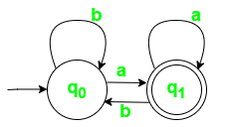
Example:
Let a deterministic finite automaton be →
Construct a DFA that accepts all strings ending with ‘a’.
Given:
Σ = {a, b},
Q = {q0, q1},
F = {q1}
Transition function δ as shown by the following transition diagram and transition table
_{State}\^{Symbol} | a | b
q₀ | q₁ | q₀
q₁ | q₁ | q₀
If the string ends in ‘a’, the machine reaches state q1, which is an accepting state.

Slide 22
Non Deterministic Finite Automata
In NDFA, for a particular input symbol, the machine can move to any combination of the states in the machine. (The machine have multiple paths on one input symbol)
In other words, the exact state to which the machine moves cannot be determined. Hence, it is called Non-deterministic Automaton.
As it has finite number of states, the machine is called Non-deterministic Finite Machine or Non-deterministic Finite Automaton.
Formal Definition of an NDFA:
An NDFA can be represented by a 5-tuple (Q, ∑, δ, q₀, F) where
Q is a finite set of states.
∑ is a finite set of symbols called the alphabets.
δ is the transition function where δ: Q × ∑ → 2^{Q}
(Here the power set of Q (2^{Q}) has been taken because in case of NDFA, from a state, transition can occur to any combination of Q states)
q₀ is the initial state from where any input is processed (q₀ ∈ Q).
F is a set of final state/states of Q (F ⊆ Q).

Slide 23
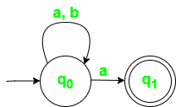
Non Deterministic Finite Automata
NFA is similar to DFA but includes the following features:
It can transition to multiple states for the same input.
It allows null (ϵ) moves, where the machine can change states without consuming any input.
Example
Let a non-deterministic finite automaton be →
Construct an NFA that accepts strings ending in ‘a’.
Given:
Σ = {a, b}, Q = {q0, q1}, F = {q1}
The transition function δ as shown below by the transition diagram and transition table −
_{State}\^{Symbol} | a | b
q₀ | {q₀,q₁} | q₀
q₁ | φ | φ
if any transition leads to an accepting state, the string is accepted.

Slide 24
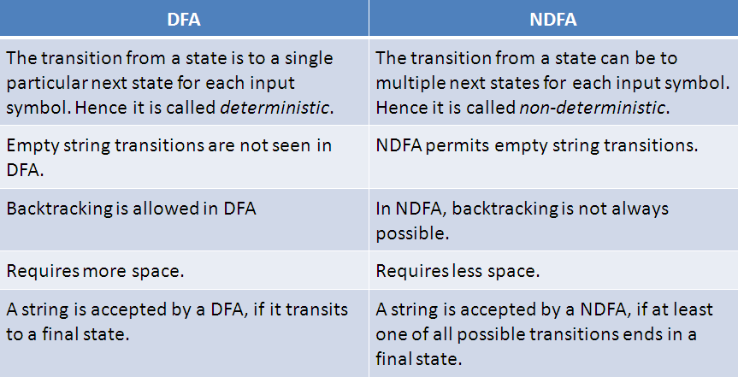
DFA vs. NDFA

Slide 25

Examples of FA
Example 1:
Design a FA with ∑ = {0, 1} accepts those string which starts with 1 and ends with 0.
Solution:
The FA will have a start state q0 from which only the edge with input 1 will go to the next state q1.
In state q1, if we read 1, we will be in state q1, but if we read 0 at state q1, we will reach to state q2 which is the final state.
In state q2, if we read either 0 or 1, we will go to q2 state or q1 state respectively.
Note that if the input ends with 0, it will be in the final state

Slide 26

Example 2:
Design a FA with ∑ = {0, 1} accepts the only input string 101.
Solution:
In the given solution, we can see that only input string 101 will be accepted.
Hence, for input 101, there is no other path shown for other input.

Slide 27
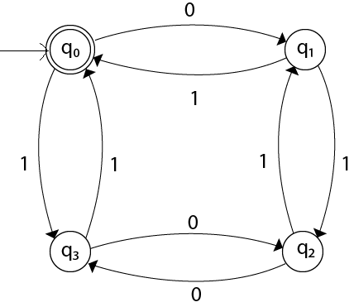
Example 3:
Design FA with ∑ = {0, 1} accepts even number of 0's and even number of 1's.
Solution:
This FA will consider four different stages for input 0 and input 1. The stages could be:

Slide 28
DFA- Practice Problems
Design a FA that accepts set of strings such that every string ends in 00,over alphabet ∑={0,1}.
Construct a FA that accept set of strings where the number of 0’s in every
string is multiple of three over alphabet ∑={0,1}.
Design a FA which accepts set of strings containing exactly four 1’s in every string over alphabet ∑={0,1}.
Design a FA that accept strings containing exactly one 1 over alphabet
∑={0,1}.
Give a DFA for Σ = {0, 1} and strings that have an odd number of 1’s and any number of 0’s.
Give a DFA for Σ = {a, b, c} that accepts any string with "aab" as a substring.
Give a DFA for Σ = {a, b} that accepts any string with "aababb" as a substring.

Slide 29
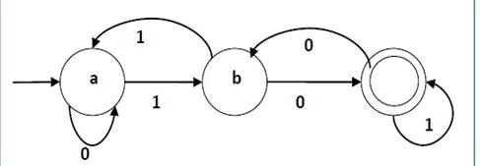
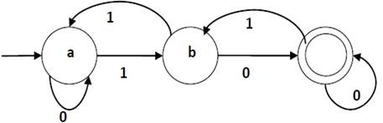
DFA- Practice Problems
9. For the given FA write the language and also give the transition table.
10. For the given FA write the language and also give the transition table.

Slide 30
DFA- Practice Problems
Design a FA over alphabet ∑={0,1},which accept the set of strings either start with 01 or end with 01.
Give the DFA accepting the set of strings over alphabet ∑={0,1},such that in each string number of 0’s is divisible by five and number of 1’s is divisible by 3.
Construct DFA which accept a language ∑={a,b} of all strings containing ‘a’
Construct DFA which accepts all the strings over an alphabet ∑={a,b} where length of a string =2.

Slide 31
NFA-Practice Problems
Design a NFA for the language L=all string over {0,1} that have at least two consecutive 0’s or 1’s.
Draw the state diagram for NFA accepting language L=(ab)*(ba)* U aa*.
Draw the state diagram for NFA accepting language L=(aba)*
U aa*.
Draw the state diagram for NFA accepting language L={(a^{n}:n>=0) U (b^{n}a:n>=1)}.
Draw the state diagram for NFA accepting language L=
={(a^{n}:n>=0) U (b^{n}:n>=0)}.

Slide 32
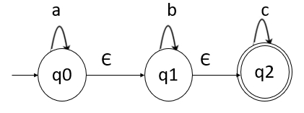
Epsilon(ε) closure
A set of states that are reached from the state ‘q’ on ε-transitions.
ε-closure (P) = P, where P ∈ Q
If there exists ε-closure (P) = {q} and 𝛿(q, ε) =r then, ε-closure (P) = {q, r}
Here,
ε-closure (q0)= {q0,q1,q2}
self state+ ε-reachable states.
ε-closure (q1)= { q1,q2}
q1 is self-state and q2 is a state obtained from q1 with epsilon input.
ε-closure (q2)= {q2}

Slide 33
Conversion Of E-NFA To NFA
The Process Of Conversion Of ε-NFA To NFA Is Called As Thomson Construction.
Note:-
No Change In Initial State
No Change In The Total No. Of States
May Be Change In Final States
Algorithm
Let M=(Q,Σ,δ,q₀,F) – ε-NFA
M¹= (Q¹,Σ,δ¹,q₀¹,F¹) – NFA
Initial State
q₀¹=q₀
Construction Of δ¹
_{δ}1
(q,x)=ε-Closure(δ(ε-Closure(q),x)
Final State
Every State Who’s ε-Closure Contain Final State Of ε-NFA Is Final State In NFA

Slide 34
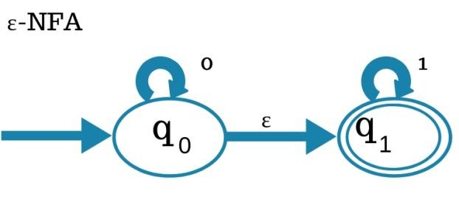
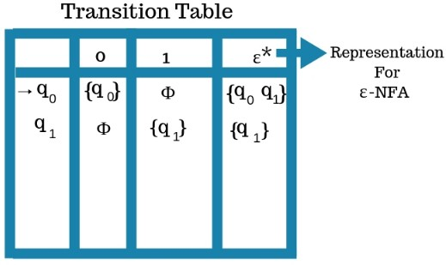
Conversion Of E-NFA To NFA -example
ε-Closure(q₀)-{q₀,q₁}
ε-Closure(q₁)-{q₁}
Initial State : q0
Construction Of δ¹
δ¹=(q₀,0)=ε-Closure(δ(ε-Closure(q₀,0)
=ε-Closure(δ({q₀,q₁},0))
=ε-Closure(q₀)
={q₀,q₁}

Slide 35
Conversion Of E-NFA To NFA -example
δ¹=(q₀,1)=ε-Closure(δ(ε-Closure(q₀,1)
=ε-Closure(δ({q₀,q₁},1))
=ε-Closure(q₁)
={q₁}
δ¹=(q₁,0)=ε-Closure(δ(ε-Closure(q₁,0)
=ε-Closure(δ({q₁},0))
=ε-Closure(Φ)
=Φ
δ¹=(q₁,1)=ε-Closure(δ(ε-Closure(q₁,1)
=ε-Closure(δ({q₁},1))
=ε-Closure(q₁)
={q₁}

Slide 36
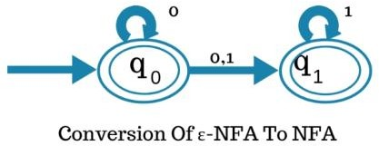
Conversion Of E-NFA To NFA -example
3. Final State?
q₀ & q₁ Both Are Final States Because ε-Closure(q₀)={q₀,q₁}
ε-Closure(q₁)={q₁}

Slide 37
Conversion from NFA to DFA
Let, M = (Q, ∑, δ, q0, F) is an NFA which accepts the language L(M). There should be equivalent DFA denoted by M' = (Q', ∑', q0', δ', F') such that L(M) = L(M').
Steps for converting NFA to DFA:
Step 1: Initially Q' = ϕ
Step 2: Add q0 of NFA to Q'. Then find the transitions from this start state.
Step 3: In Q', find the possible set of states for each input symbol. If this set of states is not in Q', then add it to Q'.
Step 4: In DFA, the final state will be all the states which contain F(final states of NFA)

Slide 38
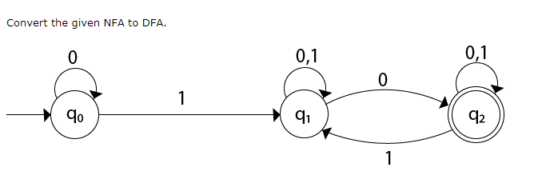
Conversion from NFA to DFA-Example
State | 0 | 1
→q0 | q0 | q1
q1 | {q1, q2} | q1
*q2 | q2 | {q1, q2}

Slide 39
Conversion from NFA to DFA-Example
δ'([q0], 0) = [q0]
δ'([q0], 1) = [q1]
The δ' transition for state q1 is obtained as:
δ'([q1], 0) = [q1, q2] (new state generated)
δ'([q1], 1) = [q1]
The δ' transition for state q2 is obtained as: δ'([q2], 0) = [q2]
δ'([q2], 1) = [q1, q2]
Now we will obtain δ' transition on [q1, q2].
δ'([q1, q2], 0) = δ(q1, 0) 𝖴 δ(q2, 0)
= {q1, q2} 𝖴 {q2}
= [q1, q2]
δ'([q1, q2], 1) = δ(q1, 1) 𝖴 δ(q2, 1)
= {q1} 𝖴 {q1, q2}
= {q1, q2}
= [q1, q2]

Slide 40
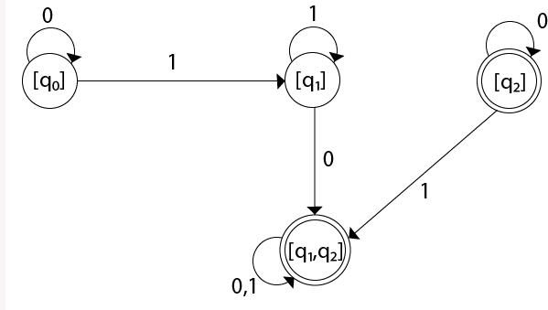
Conversion from NFA to DFA-Example
The state [q1, q2] is the final state as well because it contains a final state q2.
The transition table for the constructed DFA will be:
State | 0 | 1
→[q0] | [q0] | [q1]
[q1] | [q1, q2] | [q1]
*[q2] | [q2] | [q1, q2]
*[q1, q2] | [q1, q2] | [q1, q2]
Note: The state q2 can be eliminated because q2 is an unreachable state

Slide 41
Minimization of FSM:
Suppose there is a DFA ,D < Q, ∑, q0, δ, F > which recognizes a language
L. Then the minimized DFA D < Q’, ∑, q0, δ’, F’ > can be constructed for language L as:
Step 1: We will divide Q (set of states) into two sets. One set will contain all final states and other set will contain non-final states. This partition is called P0.
Step 2: Initialize k = 1
Step 3: Find P_{k} by partitioning the different sets of P_{k-1}. In each set of P_{k-1}, we will take all possible pair of states. If two states of a set are distinguishable, we will split the sets into different sets in P_{k}.
Step 4: Stop when P_{k} = P_{k-1} (No change in partition)
Step 5: All states of one set are merged into one. No. of states in minimized DFA will be equal to no. of sets in P_{k}.

Slide 42
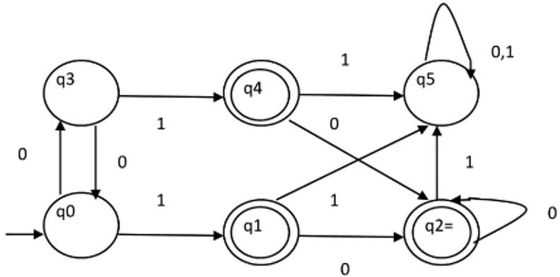
Minimization of FSM:
Example
Consider the following DFA shown in figure.

Slide 43
Minimization of FSM:
Step 1. P0 will have two sets of states. One set will contain q1, q2, q4 which are final states of DFA and another set will contain remaining states. So P0 = {
{ q1, q2, q4 }, { q0, q3, q5 } }.
Step 2. To calculate P1, we will check whether sets of partition P0 can be partitioned or not:
For set { q1, q2, q4 } :
δ ( q1, 0 ) = δ ( q2, 0 ) = q2 and δ ( q1, 1 ) = δ ( q2, 1 ) = q5, So q1 and q2 are
not distinguishable.
Similarly, δ ( q1, 0 ) = δ ( q4, 0 ) = q2 and δ ( q1, 1 ) = δ ( q4, 1 ) = q5, So q1 and q4 are not distinguishable.
Since, q1 and q2 are not distinguishable and q1 and q4 are also not distinguishable, So q2 and q4 are not distinguishable. So,
{ q1, q2, q4 } set will not be partitioned in P1.

Slide 44
Minimization of FSM:
For set { q0, q3, q5 } :
δ ( q0, 0 ) = q3 and δ ( q3, 0 ) = q0 δ ( q0, 1) = q1 and δ ( q3, 1 ) = q4
Moves of q0 and q3 on input symbol 0 are q3 and q0 respectively which are in same set in partition P0. Similarly, Moves of q0 and q3 on input symbol 1 are q3 and q0 which are in same set in partition P0. So, q0 and q3 are not distinguishable.
δ ( q0, 0 ) = q3 and δ ( q5, 0 ) = q5 and δ ( q0, 1 ) = q1 and δ ( q5, 1 ) = q5 Moves of q0 and q5 on input symbol 0 are q3 and q5 respectively which are in different set in partition P0. So, q0 and q5 are distinguishable. So, set { q0, q3, q5 } will be partitioned into { q0, q3 } and { q5 }. So,
P1 = { { q1, q2, q4 }, { q0, q3}, { q5 } }

Slide 45
Minimization of FSM:
To calculate P2, we will check whether sets of partition P1 can be partitioned or not:
⚫
For set { q1, q2, q4 } :
δ ( q1, 0 ) = δ ( q2, 0 ) = q2 and δ ( q1, 1 ) = δ ( q2, 1 ) = q5, So q1 and q2 are not distinguishable.
Similarly, δ ( q1, 0 ) = δ ( q4, 0 ) = q2 and δ ( q1, 1 ) = δ ( q4, 1 ) = q5, So q1 and q4 are not distinguishable.
Since, q1 and q2 are not distinguishable and q1 and q4 are also not
distinguishable, So q2 and q4 are not distinguishable. So,
{ q1, q2, q4 } set will not be partitioned in P2.

Slide 46
Minimization of FSM:
For set { q0, q3 } :
δ ( q0, 0 ) = q3 and δ ( q3, 0 ) = q0 δ ( q0, 1 ) = q1 and δ ( q3, 1 ) = q4
Moves of q0 and q3 on input symbol 0 are q3 and q0 respectively which are in same set in partition P1. Similarly, Moves of q0 and q3 on input symbol 1 are q3 and q0 which are in same set in partition P1. So, q0 and q3 are not distinguishable.
For set { q5 }:
Since we have only one state in this set, it can’t be further partitioned. So,
P2 = { { q1, q2, q4 }, { q0, q3 }, { q5 } }
Since, P1=P2. So, this is the final partition. Partition P2 means that q1, q2 and q4 states are merged into one. Similarly, q0 and q3 are merged into one.
Minimized DFA corresponding to DFA of Figure 1 is shown in Figure 2 as:

Slide 47
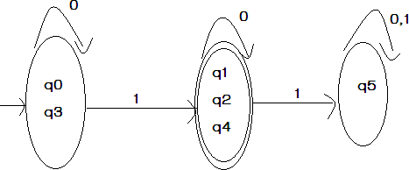
Minimization of FSM:

Slide 48
Equivalence between two FSM’s:
Definition : (equivalence of finite state machines): Two finite state machines M1 and M2 are equivalent (M1≡M2) if they have the same input and output alphabets and if, starting from their respective initial states, they produce the same output for any input string.

Slide 49
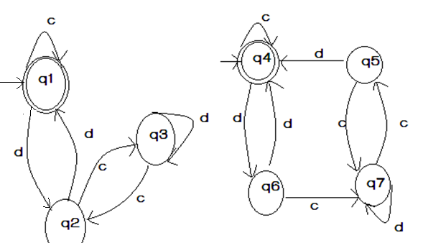
Equivalence between two FSM’s:

Slide 50
Equivalence between two FSM’s:
Solution: The initial states in M1 and M2 are q1 and q4. |Let us see that combined transition of M1 and M2 on inputs c and d as follows:
States/Inputs | c | d
(q1,q4) | (q1,q4) | (q2,q6)
(q2,q6) | (q3,q7) | (q1,q4)
(q3,q7) | (q2,q5) | (q3,q7)
(q2,q5) | (q3,q7) | (q1,q4)

Slide 51
Equivalence between two FSM’s:
(q1,q4) is new state
(q2,q6) is new state
(q3,q7) is new state
(q2,q5) is new state
Let us analyze the above transition table carefully, then we find that, the behavior of M1 and M2 is similar.
We do not get a pair (q , q’) where q is a final state ,and q’ is a non final state (or vice versa) at every row. Therefore M and M’ are equivalent.

